Slide 1
Computer Architecture Basics
Notes:
Let’s start by reviewing a few basic facts about your computer.

Slide 2
Computers Use a Layered Architecture
Applications
Python interpreter, command shell, Git, web browser
Operating system
Hardware
CPU, memory, display, storage
Notes:
First, computers are organized into layers. A computer scientist would say they have a layered architecture.
Here’s a simplified view with the most important layers. At the bottom, there’s hardware.
Above the hardware sits the operating system. This could be Windows, Mac OS, Unix or some variant of Unix. In one sense the operating system hides the details of the hardware below. If you’re using a computer, you don’t want to worry about things like what type of drive your data is on, and at what memory addresses. The OS hides all that and gives you a simple abstraction that’s pretty consistent across computers with different hardware.
Finally, applications are programs that run on top of the OS. This includes your python interpreter, your command shell, and many others.

Slide 3
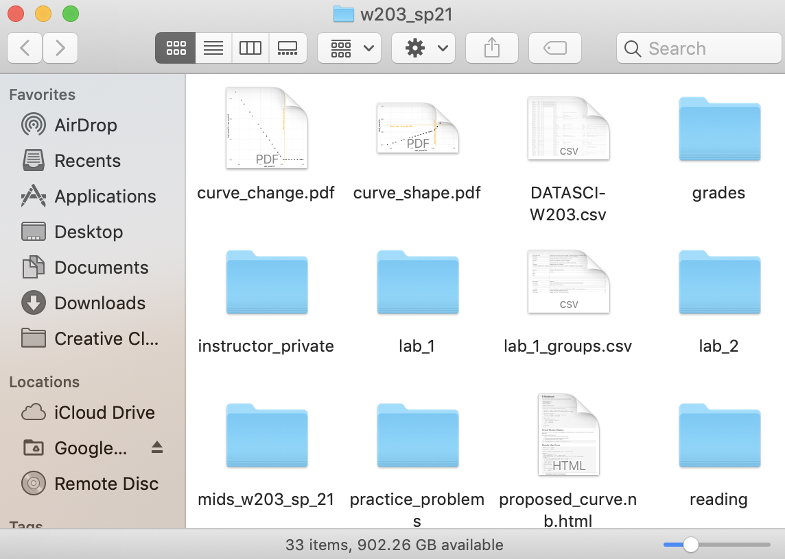
Files and Directories
Notes:
At the operating system level, all data is organized into files, and those files are located inside directories. you may also hear directories called folders. a folder can contain files and also other directories.

Slide 4
The Directory Tree
Absolute paths
/Users/rob
~/Desktop/pics/cat.jpg
Relative paths
../../Documents/w200
/
Library
bin
Users
paul
rob
Desktop
Documents
pics
w200
cat.jpg
hw1.py
hw2.py
Notes:
Overall, the directories on your computer can be depicted as a tree. The gray nodes are directories, and the orange nodes are files. If you look at a directory, the lines that come down show you the files and other directories that are contained inside. If you start at any node (except the top), there is one line going up, which tells you what directory that node is inside.
There are three special directories to keep in mind:
Root. this is the very top. On macOS and other unix-like systems, this is written with a forward slash. Windows systems are a little different, the top will be a drive partition, like a capital “C”, but there can be multiple trees. Right under the root directory are a bunch of folders that you usually don’t touch, because they contain basic system files.
Home. Each user of a computer gets their own special directory called home. on Unix-like systems, this directory get a special symbol, a tilde. On my machine, the home folders are located inside the Users directory, but some systems may be different.
Finally, when you are programming, or giving commands to a computer, you often think of yourself as being inside some directory, where you can read files and make changes. This is called a working directory. There’s not really one working directory, different programs will have different working directories. <label pics>
You specify a file or directory on your computer using a path. There are two types of paths.
An absolute path begins with the root, or with the home directory.
A relative path begins with the current working directory. Sometimes you have to first go up the tree, to get to the location you want. there is a special symbol for up, the two periods.

Slide 5
Users in Unix
Three types of users
Regular users—used by humans for interactive use
System users—used to run system processes
Root, aka superuser—has full permissions
Best practice: use a regular account with sudo to execute superuser commands
A group is a collection of users

Slide 6
File Permissions in Unix
Three actions for each file
Read
Write
Execute
Every file belongs to an owner and a group
Different users have different access levels
Can owner read/write/execute?
Can group read/write/execute?
Can others read/write/execute?

Slide 7
Computer Architecture Basics

